Slide 1
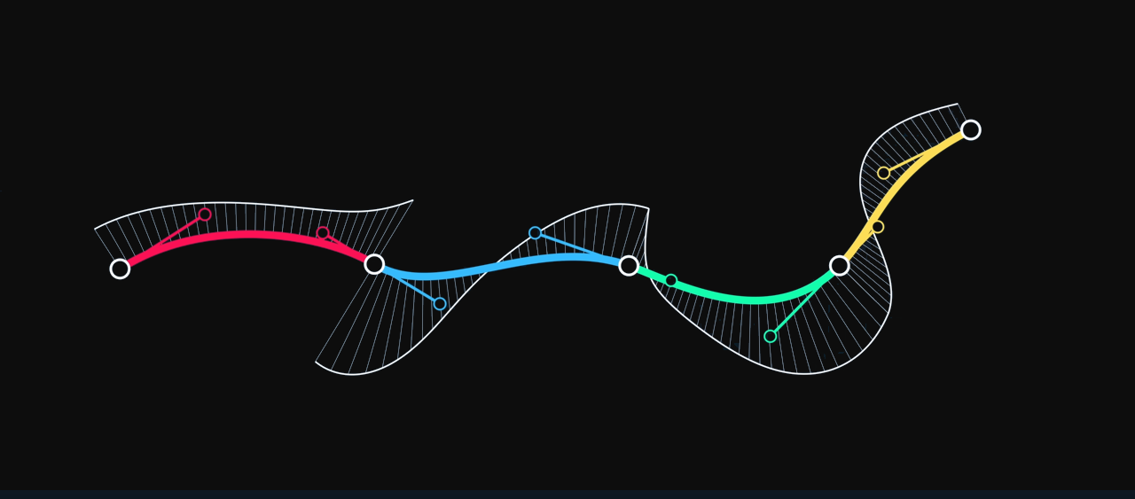



“The Continuity of Splines” ~ by Freya Holmér
Using Kolmogorov-Arnold Networks for an Interpretable and Continual Fault Detection of Helicopter Turbine Engine
Valerio Morelli
Federica Paganica
Federico Staffolani
Enrico M. Sardellini
Lucia Migliorelli
Alessandro Freddi
Università Politecnica delle Marche

Slide 2
The need for transparency and robustness in fault detection systems

Slide 3
The focus of this research
Fault detection system: an incorrect prediction can cause costly system shutdown and reconfigurations and even compromise safety.
Online pipelines: environmental conditions tend to evolve over time, requiring resilience to catastrophic forgetting.
Dual need for transparency and robustness => most current solutions rely on statistical or simple machine learning models.
Notes:
Wild- behaviour has limited its usage till now

Slide 4
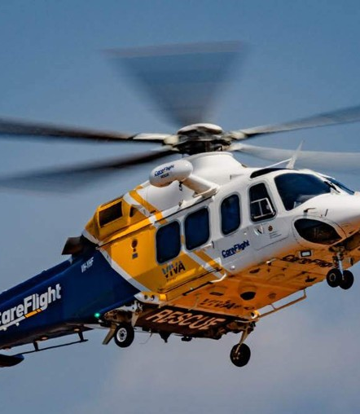
The PHM Challenge
The goal is to assess the health of helicopter turbine engines.
Regression: predict the torque margin expressed as a PDF.
Classification: detect if the engine is faulty.
Notes:
highly confident false negatives are strongly penalized.

Slide 5
The dataset has 7 features
Feature | Description
Mean gas temperature (mgt) | Average temperature inside the turbine (°C)
Pressure altitude (pa) | Height above the standard atmospheric pressure level (feet)
Indicated airspeed (ias) | Speed of the helicopter relative to the surrounding air (knots)
Compressor speed (ng) | Speed of the engine’s compressor (%)
Torque measured (Tmeasured) | Actual engine torque output (%)
Net power (np) | Effective power output of the engine (%)
Outside air temperature (oat) | Temperature of the external air (°C)

Slide 6
Kolmogorov-Arnold Network

Slide 7



The Kolmogorov-Arnold Theorem in ML
Every multivariate continuous fun $f:{\left[0,1\right]}^{n}→ℝ$, with $n≥2$, can be written as:
$$2n$$
$$2n^{2}$$
$$f\left(\vec{x}\right)=\sum_{q=0}^{2n}{ χ_{q } \left(\sum_{p=1}^{n}{ ψ_{p,q}\left(x_{p}\right)}\right)}$$
Outer funs
Inner funs
…namely as a sum of composition of a finite number of univariate functions
Notes:
Wild- behaviour has limited its usage till now

Slide 8


KAT
$$f\left(\vec{x}\right)=\sum_{q=0}^{2n}{χ_{q}\left(\sum_{p=1}^{n}{ψ_{p,q}\left(x_{p}\right)}\right)}$$
UAT
$$f\left(\vec{x}\right)=\sum_{q=0}^{∞}{ω_{q}×σ\left(\sum_{p=1}^{n}{ω_{p,q}×x_{p}}\right)}$$
Notes:
KAT has much in common with the UAT
It’s not an apporx like UAT

Slide 9
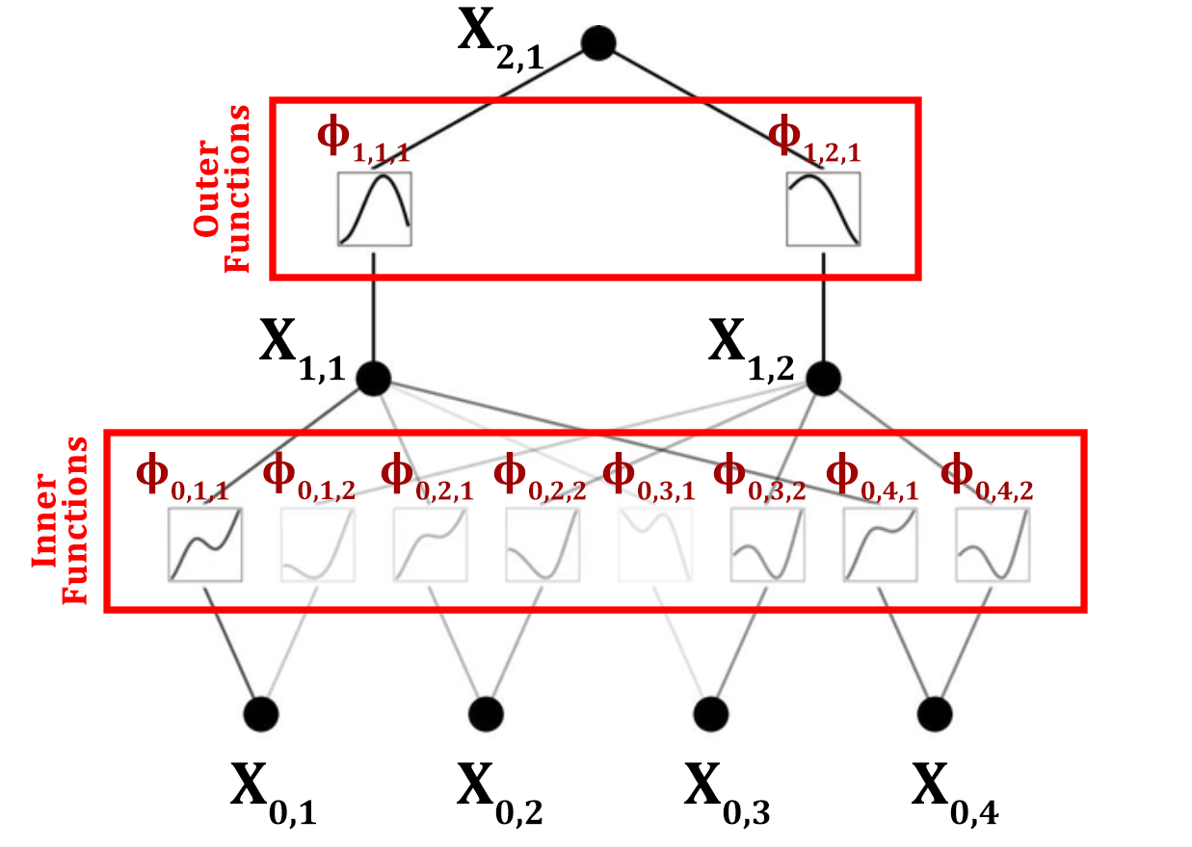
The Kolmogorov-Arnold Networks
KANs have learnable activation functions on edges, parametrized as splines
Stacking up multiple layers, KANs manage to reduce the well-known "wild behaviour" of the KAT functions.
Notes:
The real contribution of the paper lies in the generalization of the KAT in a multi-layer neural network of arbitrary width.

Slide 10
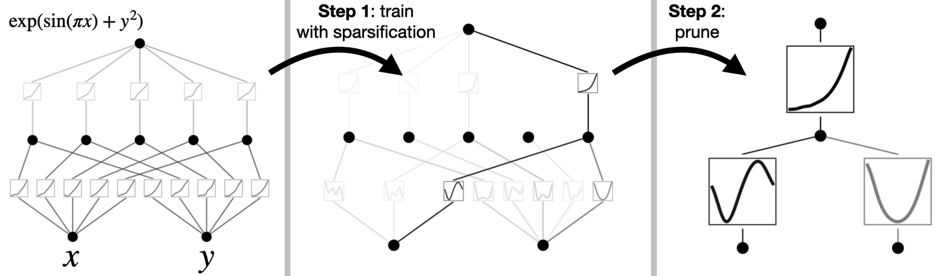
The high interpretability of KANs
After training, edges can be easily pruned, using a significance threshold.
Notes:
The real contribution of the paper lies in the generalization of the KAT in a multi-layer neural network of arbitrary width.

Slide 11
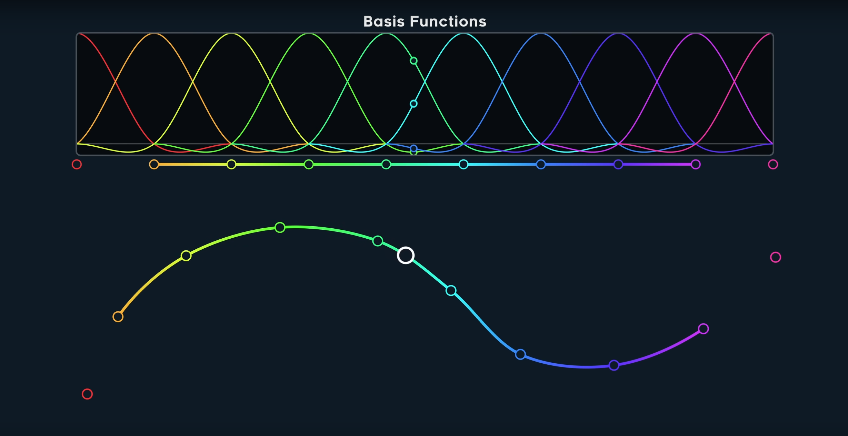
The splines
Splines are curve generators; they take some control points and produce a curve that interpolates (or not) between them.
The coefficients are given by the Basis functions

Slide 12
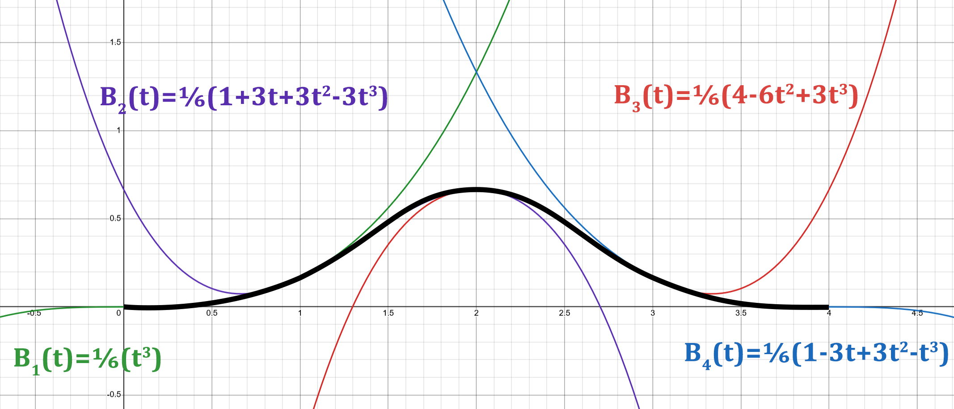
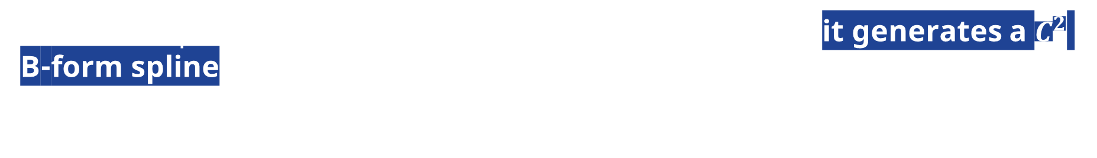
The B-Splines
When a B-Spline is convolved between the control points, it generates a $C^{2}$ B-form spline.

Slide 13

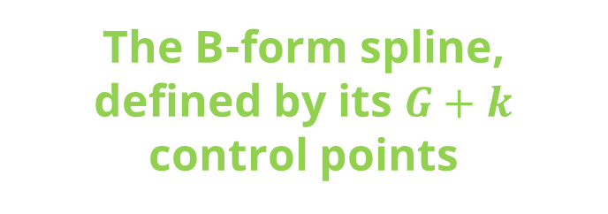
KANs choose B-form splines
The use of B-splines is supported by the findings of Carl de Boor, which proved that the KAT remains a valid approximation when B-form splines are employed.
The residual component, SiLU by default
The B-form spline, defined by its $G+k$ control points

Slide 14

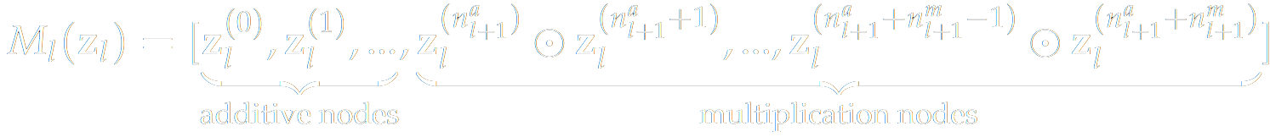


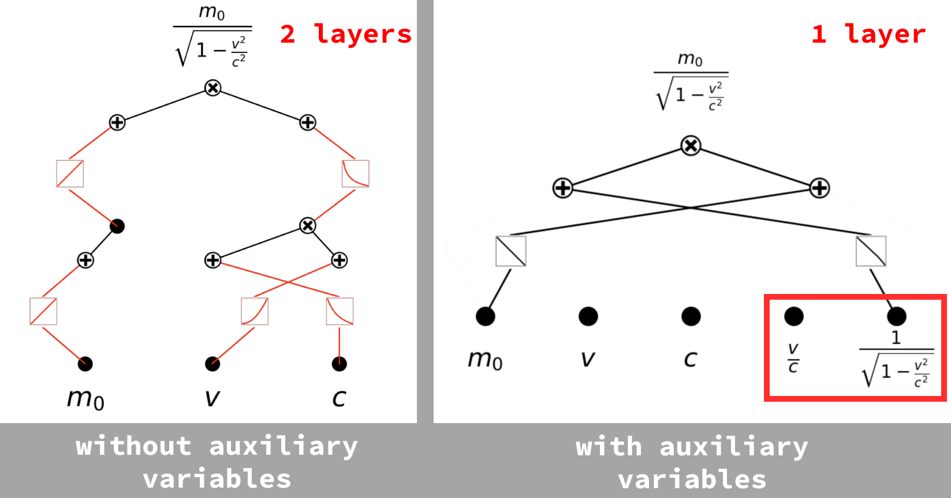
MultKANs as a generalization of KANs
On 19 August 2024, three and a half months after the introduction of KAN, the same authors published a paper on a generalization of KAN called MultKAN.
The main new feature introduced is the multiplicative node.
addition nodes
multiplication nodes
element-wise
multiplication
Auxiliary variables can be added to reduce the KAN architecture to a more interpretable one.
Sparse initialization is used to mimic the sparse connections of common formulae.
Hypothesis Testing is easy to use. MultKAN automatically saves checkpoints for rewinding.

Slide 15
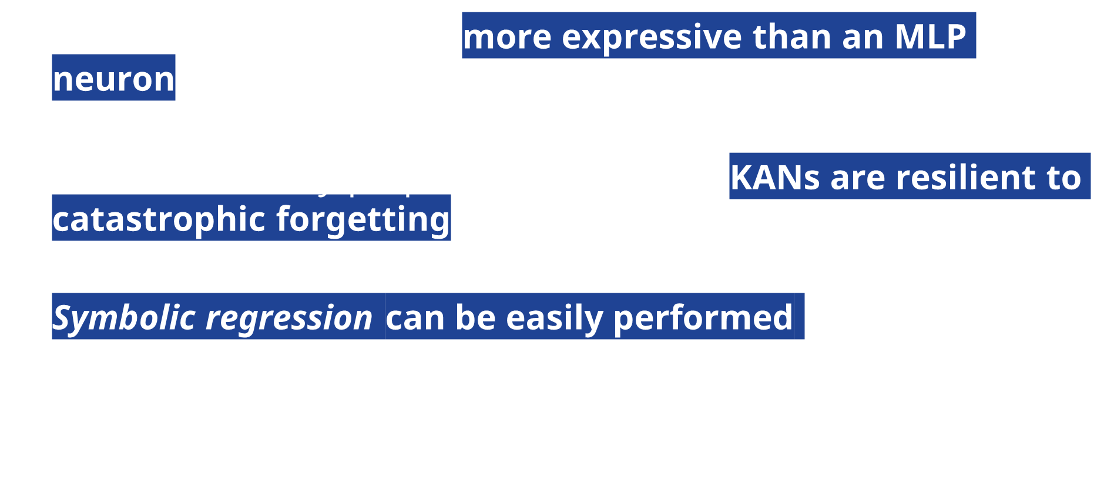
Can KANs help us?
KANs‘ “neuronal unit” is more expressive than an MLP neuron $⇒$ more interpretable.
Due to the locality property of the splines, KANs are resilient to catastrophic forgetting, whereas MLP can’t.
Symbolic regression can be easily performed by fitting a function to each spline to reveal potentially useful feature relationships.

Slide 16
Data Preprocessing

Slide 17
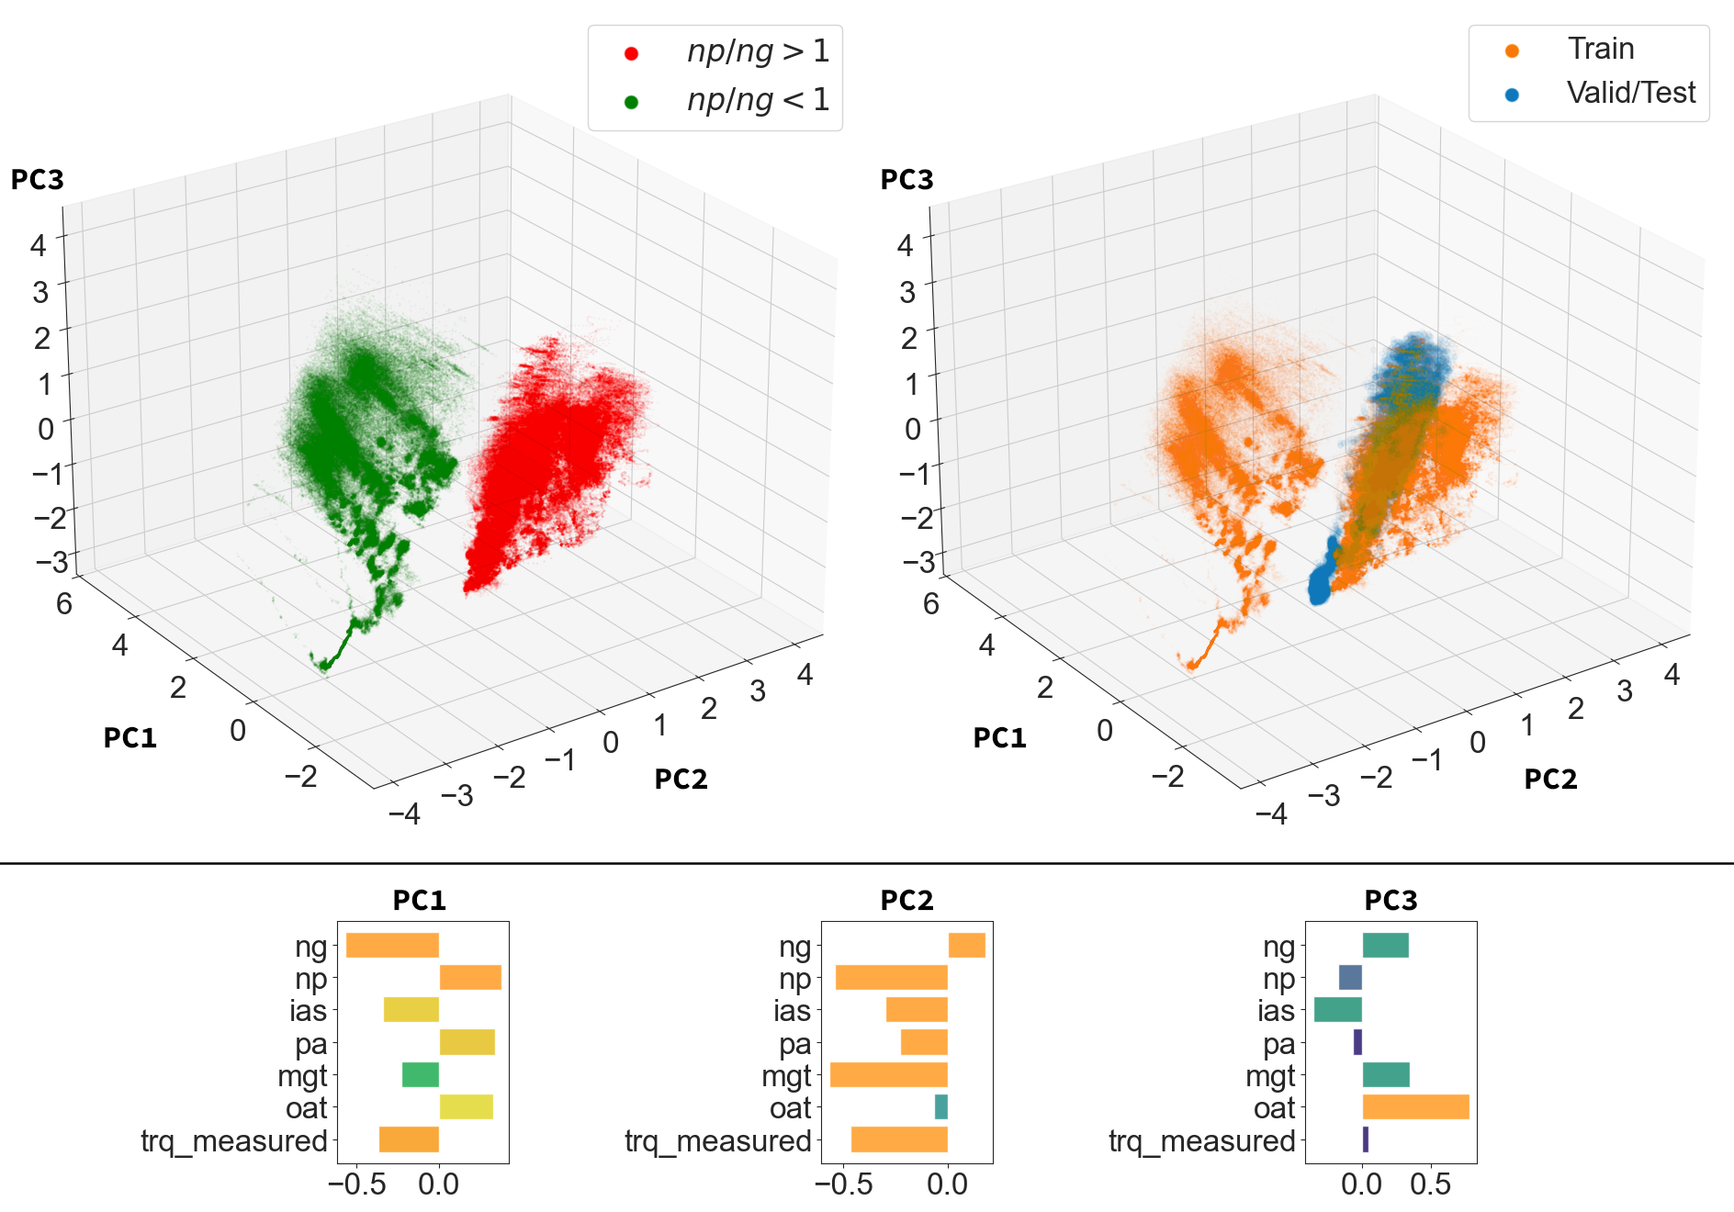
discarded

Slide 18
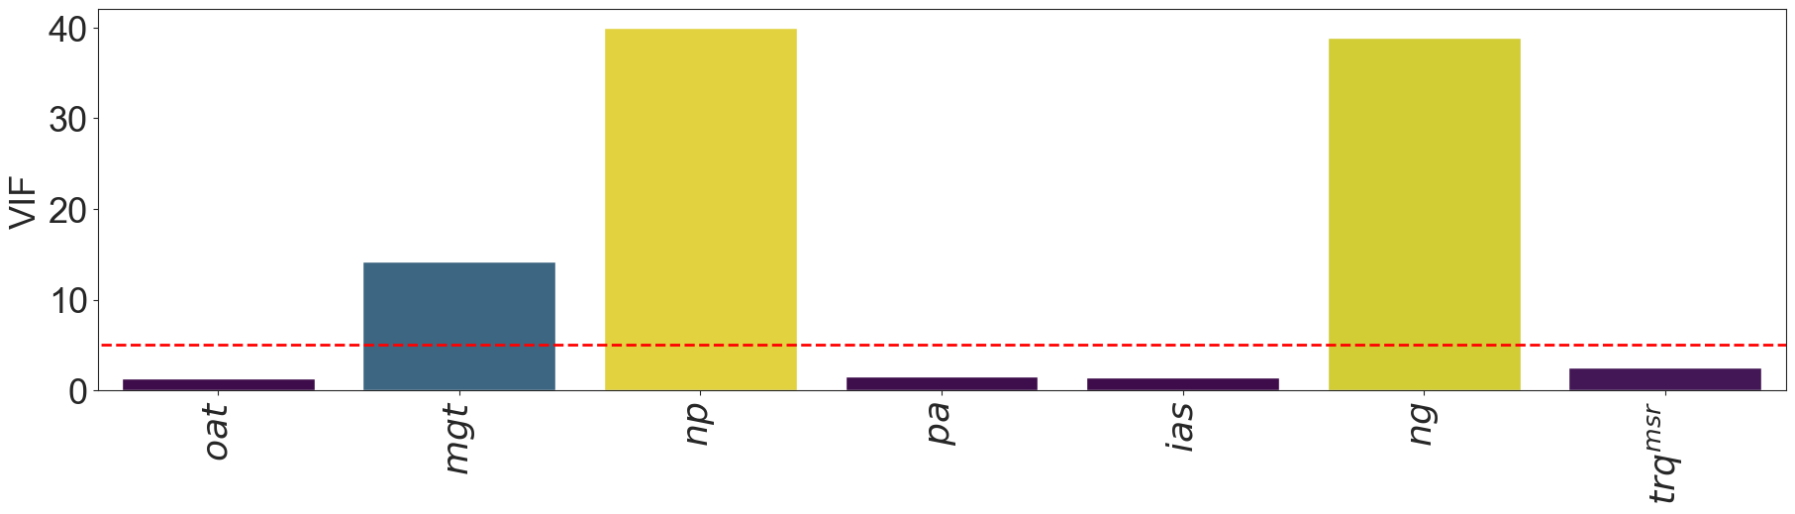
Multicollinearity check
$$np≈−1.06ng +165, R^{2}=0.975$$

Slide 19
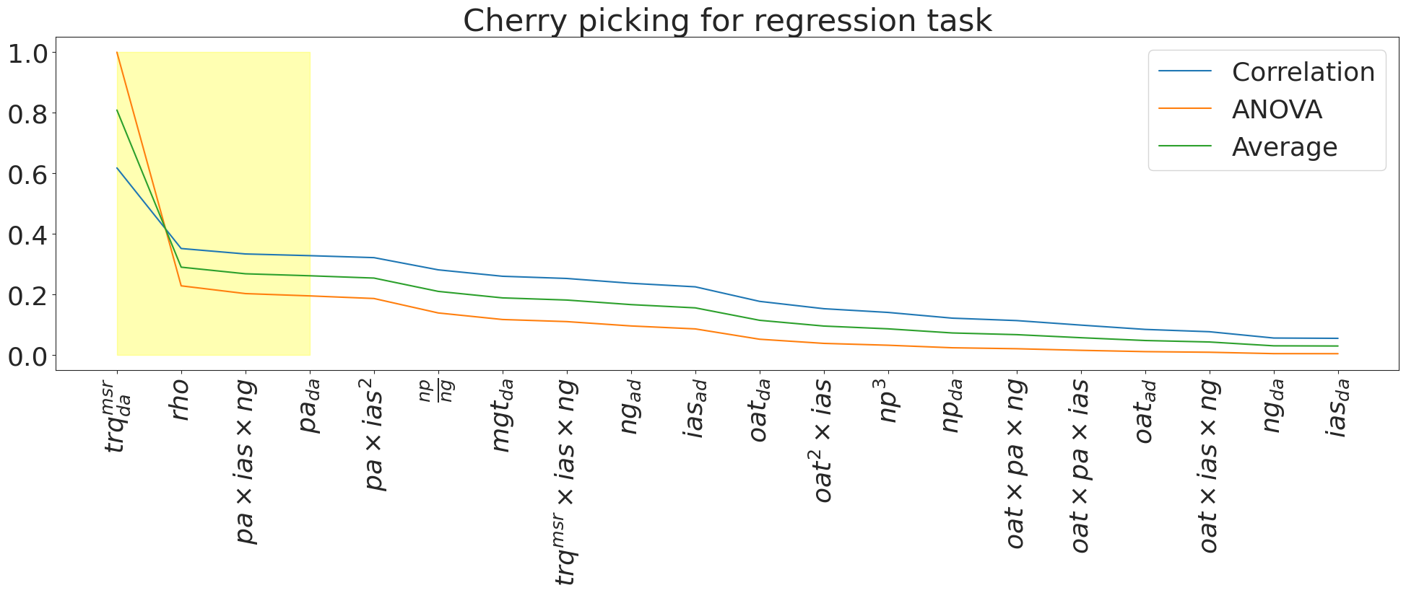
Cherry picking for regression
Notes:
Extraction for interpretability

Slide 20
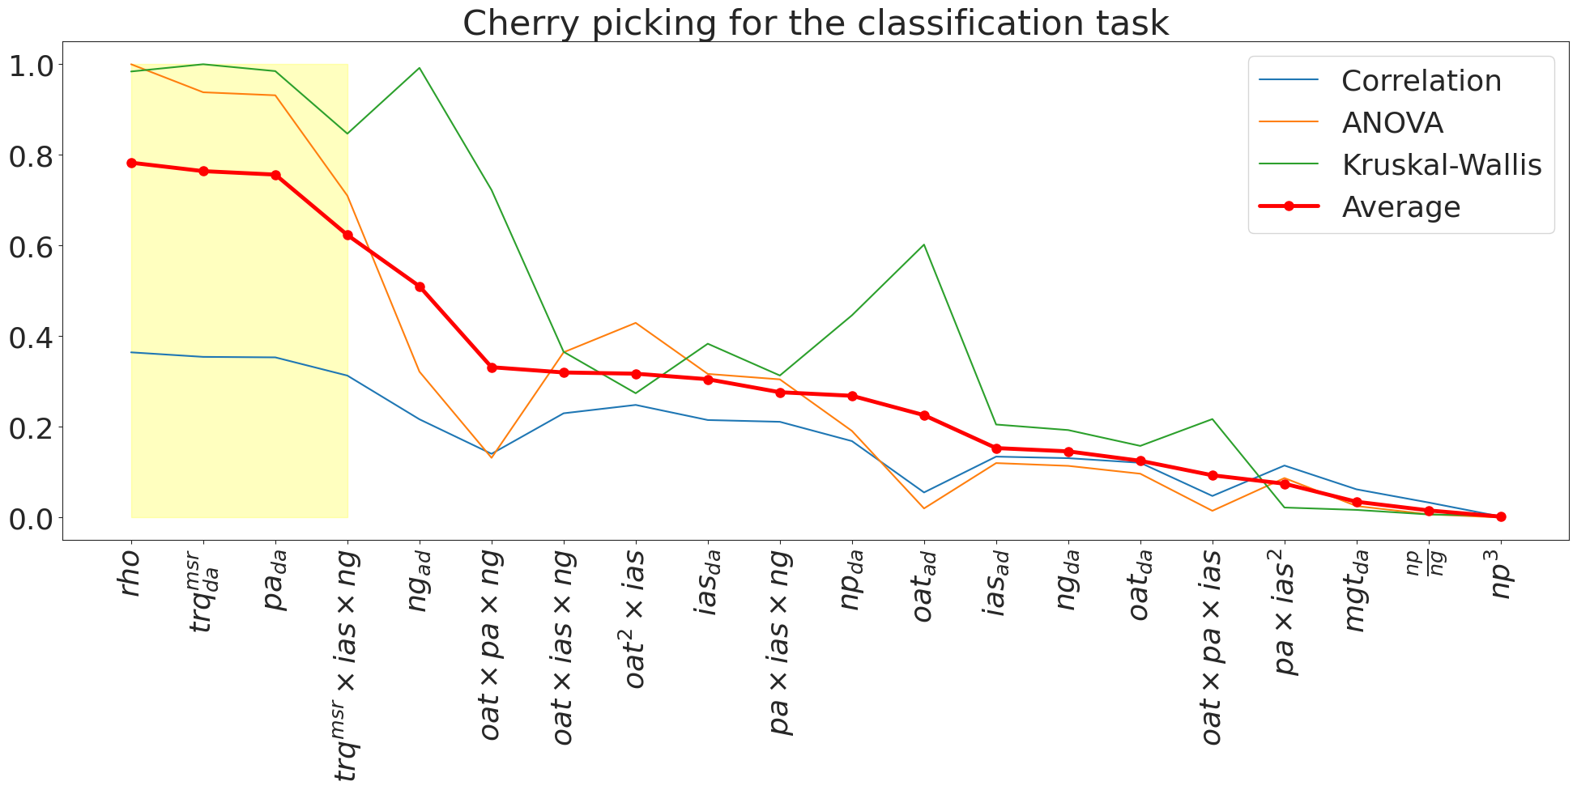
Cherry picking for classification

Slide 21
KANs are more interpretable than MLPs

Slide 22
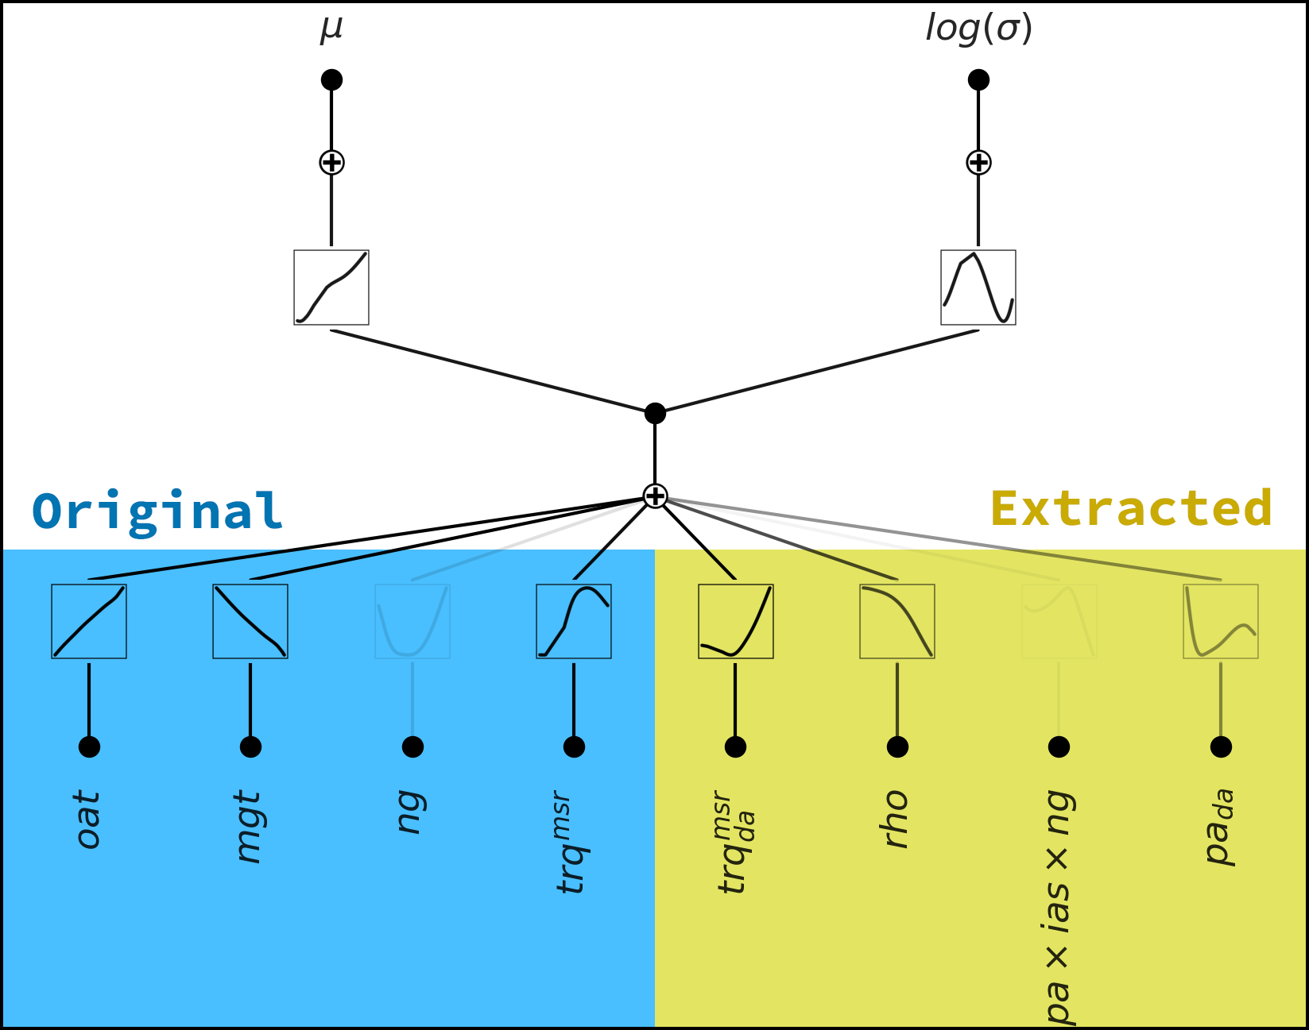
Regression

Slide 23
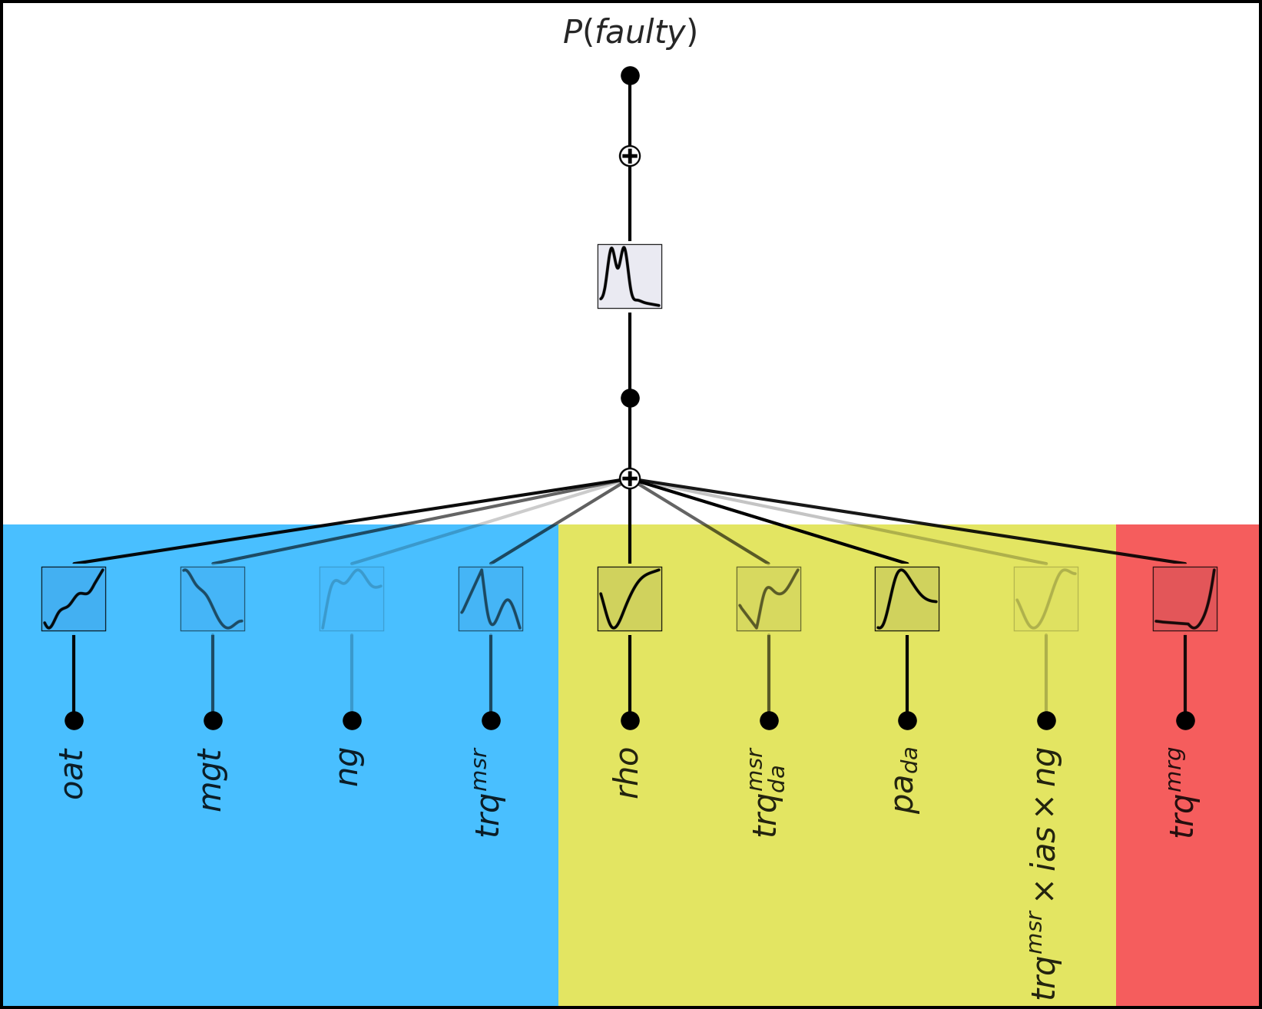


Classification

Slide 24
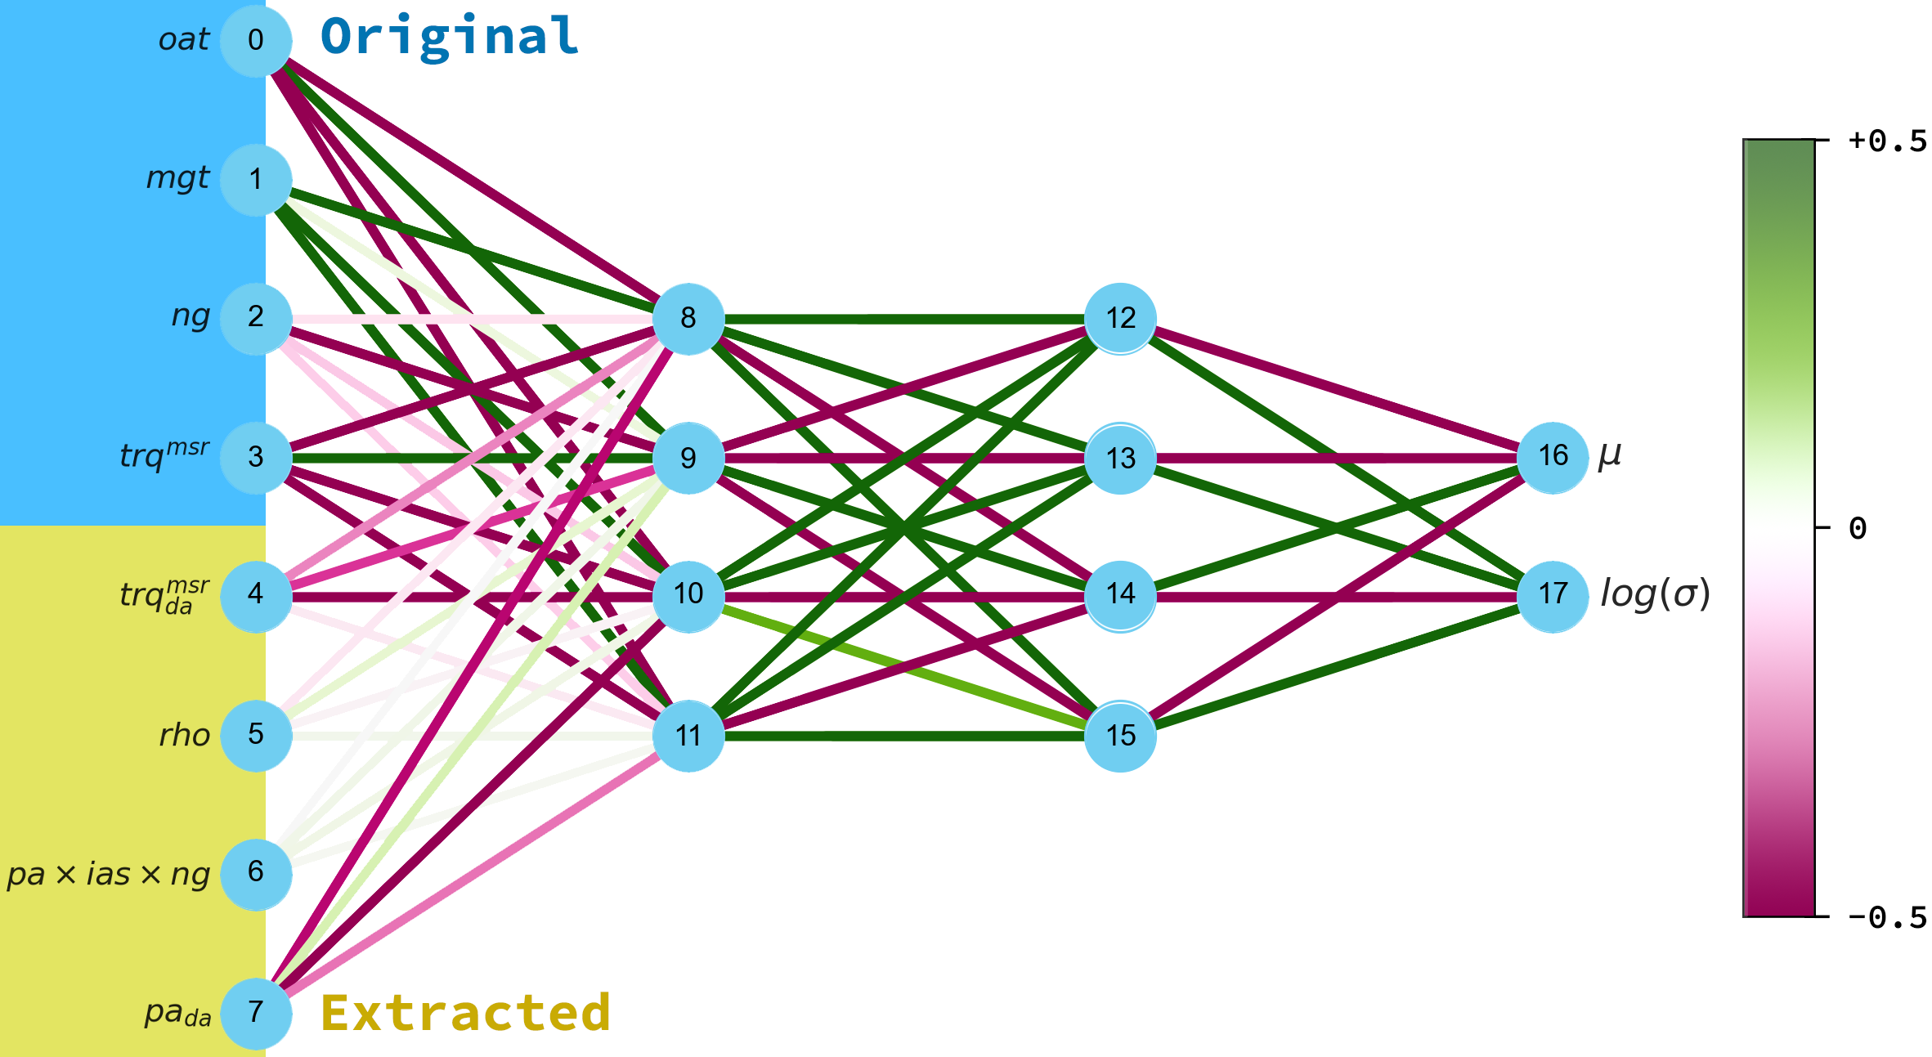
Regression

Slide 25
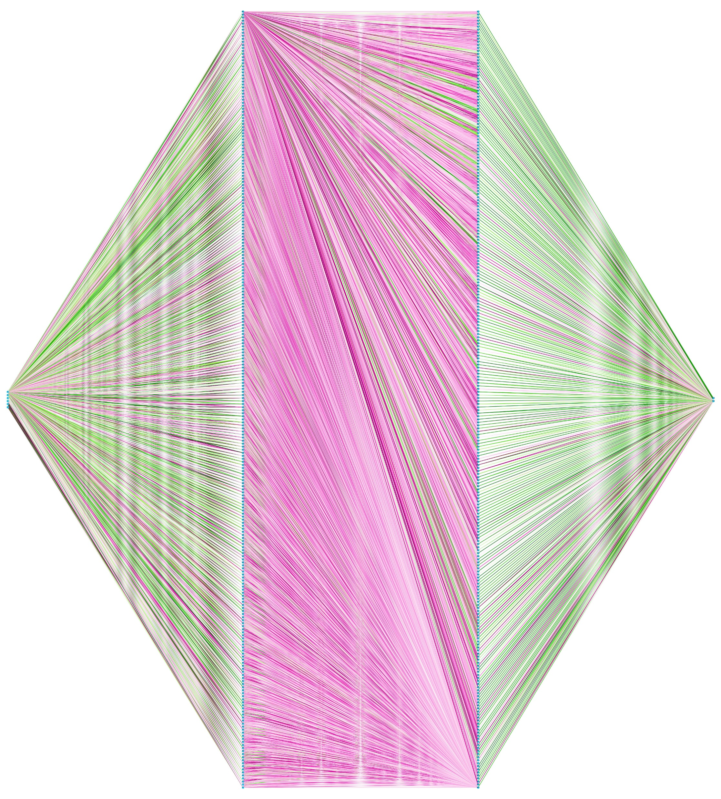
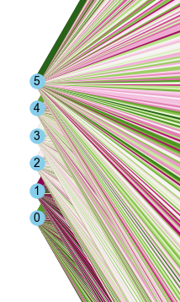
Negative weight
Positive weight
…what about interpretability?
FLOPs: 136.2 K
Params: 68.1 k

Slide 26
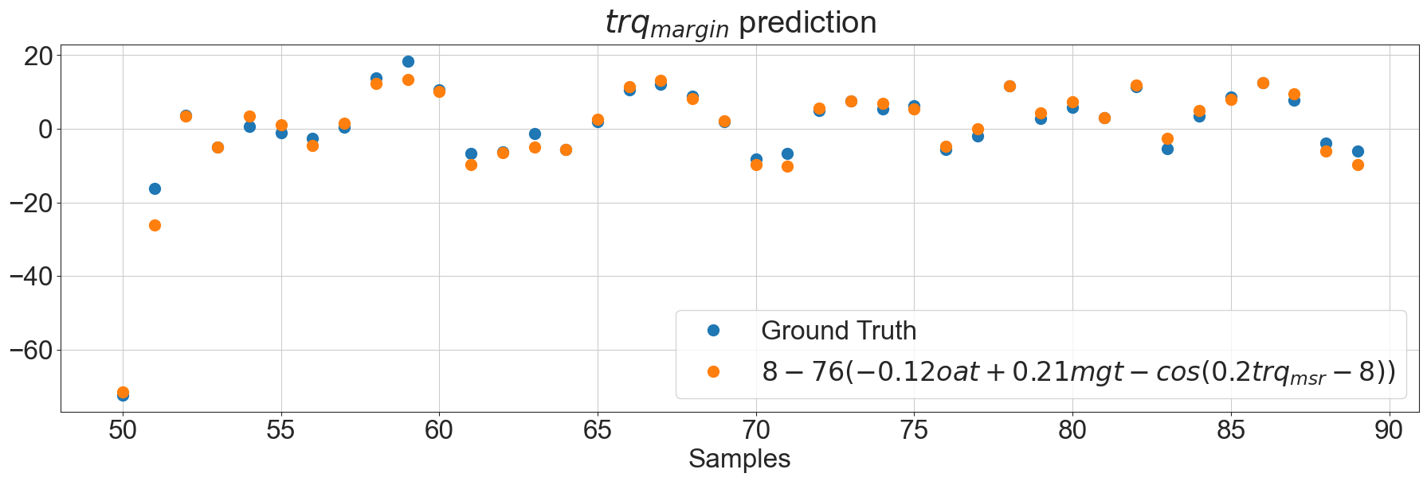
KANs are accurate
Learned splines reveal the following symbolic formula:
$$µ_{trq_{mrg}}≈ 8 −76(−0.1oat +0.2mgt−cos(0.2trq_{msr} − 8))$$

Slide 27
KANs are more resilient to catastrophic forgetting than MLPs

Slide 28
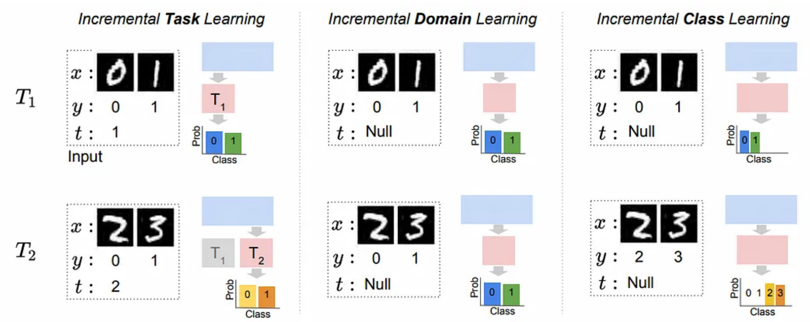
Incremental Learning Scenarios
Ven and Tolias, introduce three Incremental Learning (IL) scenarios of increasing difficulty:
Our focus

Slide 29
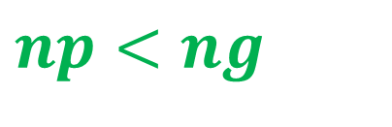
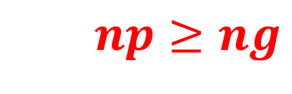
Experiment Setup
KAN and MLP are trained on the classification task once again.
The dataset is partitioned into two subsets
The test and training sets are obtained using the holdout method
The experiment is repeated with replay
The shape of the architectures is chosen to minimize the difference in terms of FLOPS
$$np<ng$$
$$np≥ng$$

Slide 30
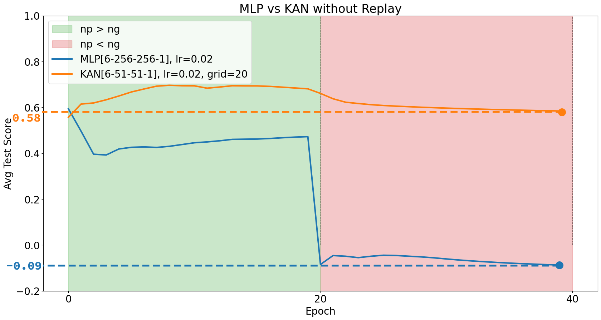

Slide 31
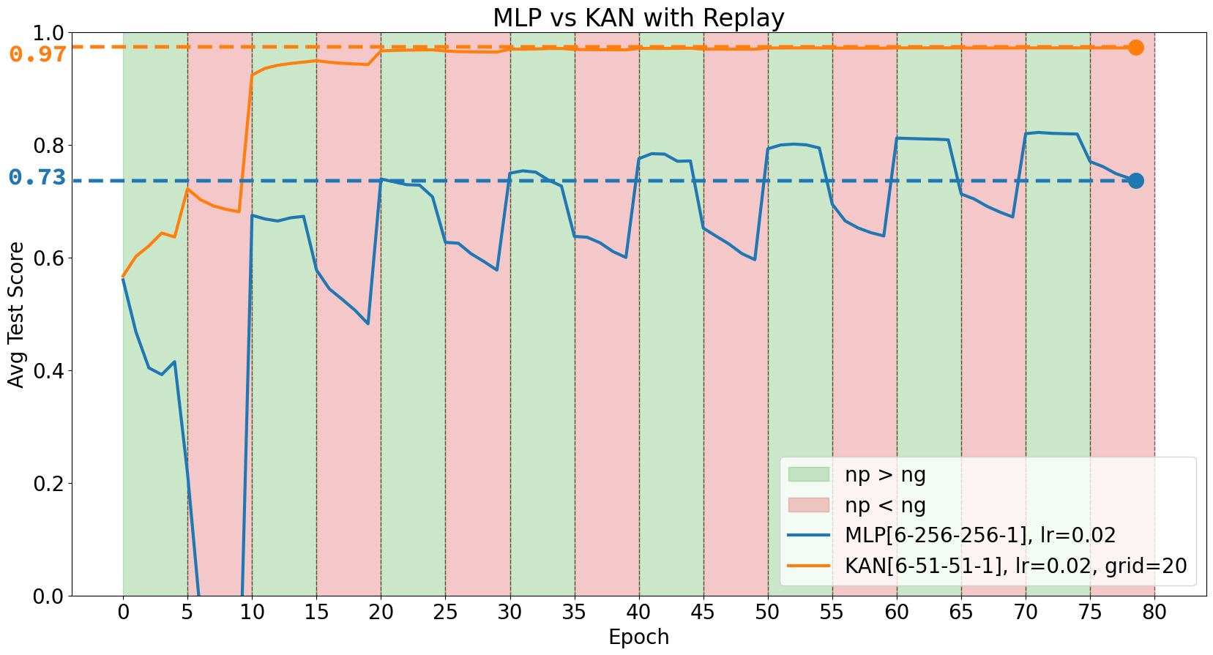

Slide 32
Conclusion
KANs provide interpretable results => We can trust predictions!
KANs resist to catastrophic forgetting => We can employ them in online pipeline!
Future work will investigate the use of multiplicative nodes to improve predictive accuracy

